Slide 1
Chapter 3 contd…
Biasing Bipolar Junction Transistors (BJTs)
© Oxford University Press 2013. All rights reserved.

Slide 2
Why do we do biasing?
We wish to establish a known dc collector current iC in BJT.
This value should be calculable, predictable and repeatable even when beta and temperature changes.
To arrange Q-point which gives us maximum signal swing in output.
To design biasing based on availability of single or dual power supply.
As a secondary consideration, design for input and output resistance of amplifier.
© Oxford University Press 2013. All rights reserved.

Slide 3
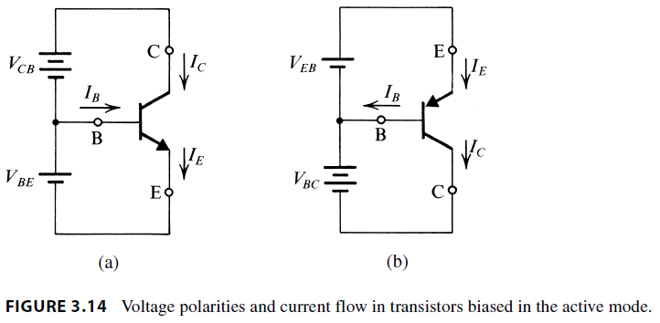
Basic guidelines for biasing
Note the power supply polarities , current directions & npn emitter at bottom and pnp emitter at top.
© Oxford University Press 2013. All rights reserved.

Slide 4
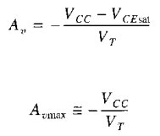
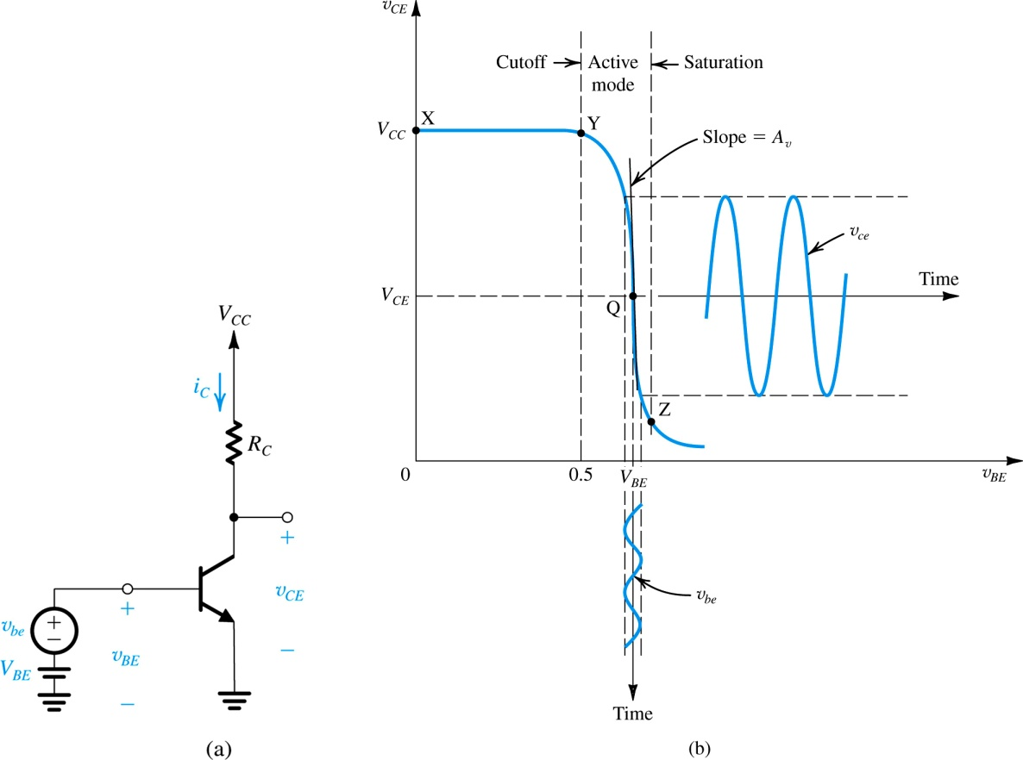
Oxford University Publishing
Microelectronic Circuits by Adel S. Sedra and Kenneth C. Smith (0195323033)

Slide 5
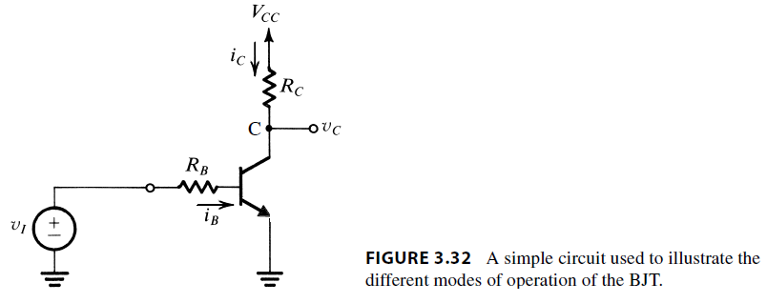
Basic Common Emitter
Amplifier without biasing
Input signal vi causes input current iB in base –> emitter circuit.
It causes collector current iC to flow in Vcc ->collector->emitter circuit.
The output signal is vo= vC.
The load could be Rc itself or another resistor Rl between collector and ground.
© Oxford University Press 2013. All rights reserved.

Slide 6
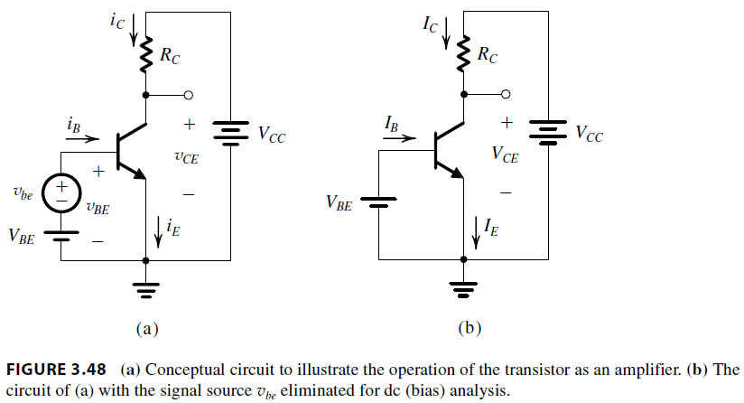
Basic Common Emitter
Amplifier with biasing
© Oxford University Press 2013. All rights reserved.

Slide 7
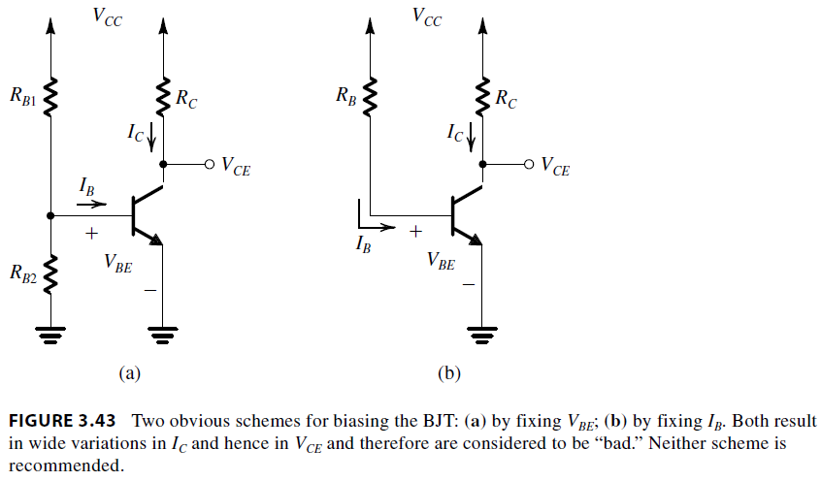
Single supply biasing
(Fixed Bias)
RB1 and RB2 form a potential divider or voltage source to provide a DC voltage VBE needed to forward bias BE JN. That decides IB.
In second case single resistor RB and VCC make a poor current source IB.
iB = (VCC-VBE)/RB
© Oxford University Press 2013. All rights reserved.

Slide 8
Issues in these schemes..
Base current depends upon VBE. If it reduces then iB increases dramatically.
If RB is made small to swamp VBE then input impedance is reduced and power supply losses increases.
If Vcc is increased to swamp VBE then power supply cost increases.
Collector current depends very much on beta. Beta variations from piece to piece cause large iC variations.
© Oxford University Press 2013. All rights reserved.

Slide 9
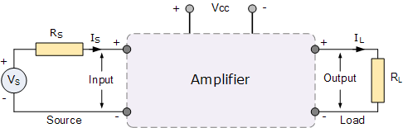
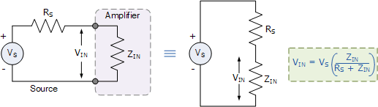
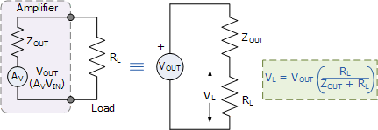

Slide 10
How to resolve this?
Add a series resistor between Emitter and ground called RE through which iE will flow.
2. In another topology add a shunt resistor between Collector and Emitter.
3. Use a current source for biasing iE.
© Oxford University Press 2013. All rights reserved.

Slide 11
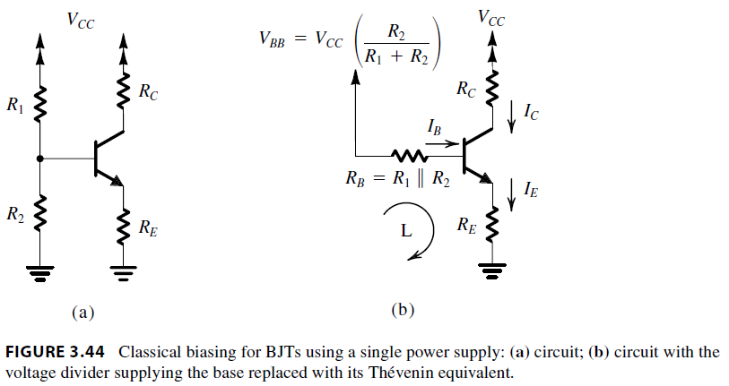
Classical Biasing of BJT
(Self Bias)
Addition of emitter resistance RE creates emitter voltage VE which opposes flow of iB.
iB = (VBB-VBE-VE)/RB
2. The opposition of VE increases as beta increases so effect of beta variation is somewhat nullified. Same for VBE variations.
© Oxford University Press 2013. All rights reserved.

Slide 12
How to choose RB1 and RB2?
Emitter current can be expressed as:
IE = (VBB-VBE) / (RE + RB/(1+beta) )
Notes:
1. If VBB >> VBE then temp variation of VBE is less troublesome. This is not possible as VCC is decided by external considerations.
2. If RE >> RB/(beta +1) then beta variations become less troublesome. Since RE shares signal voltage with RC higher RE would mean higher vE that will result in a corresponding decrease in V BE .
This in turn reduces the collector (and emitter) current, a change opposite to that originally assumed.
© Oxford University Press 2013. All rights reserved.

Slide 13
How to choose RB1 and RB2?
…. Contd
3. We can choose RB to be less compared to RE. That is current in voltage divider is >> IB.
To do this we need to choose smaller values of RB1 and RB2.
This would mean higher wasteful current drain from VCC. That is not acceptable in battery powered devices.
This will also lower input impedance of amplifier as seen between base and emitter. Not acceptable in some cases.
© Oxford University Press 2013. All rights reserved.

Slide 14
Compromise in choosing
RB1 and RB2
Apportion total supply voltage VCC in 3 equal parts - Choose VBB = 1/3 VCC.
Plan for output voltage = IC RC = 1/3 VCC
Remaining 1/3 VCC will automatically appear between C & E.
For example – if VCC = 12V then it is desirable to have IC RC = 4V, so that VC would be 8V.
Set VBB = 4V so VB will be approx. 4V and VE = VB- 0.7 = 3.3V and
VCE = 8V – 3.3V = 4.7V.
6. Select RB1 and RB2 in such a manner that divider current is 10% to 100% of desired IE.
© Oxford University Press 2013. All rights reserved.

Slide 15
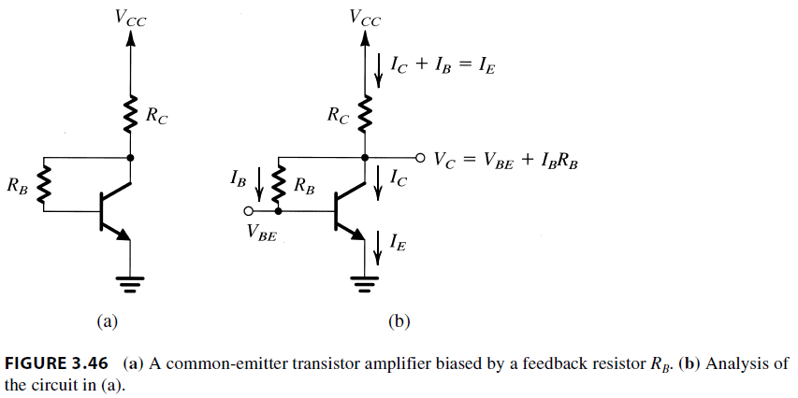

Single Supply Biasing using collector to base resistor
IE = (VCC-VBE) /
(RC + RB/ (1+beta) )
If RC>> RB/ (Beta+1) then iE will less depend upon beta.
© Oxford University Press 2013. All rights reserved.

Slide 16
Single Supply Biasing using collector to base resistor
A part of output voltage i.e. Vo or VC is fed back to input at base.
RC behaves similar to RE in providing negative feedback.
As a limiting case RB can be chosen as 0 but then VBE = VCE = 0.7V that will limit signal swing.
© Oxford University Press 2013. All rights reserved.

Slide 17
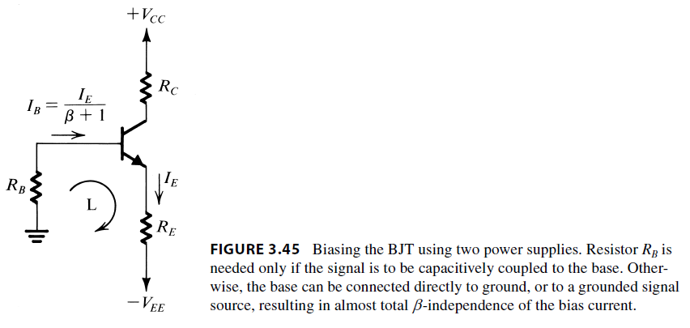
Dual Supply Biasing arrangement for grounded base.
IE = (VEE – VBE) /
(RE + (RB/beta +) )
If input signal is not fed to base then RB can be made zero and dependence on beta can be reduced.
Signal can be capacitively coupled on base or emitter as needed.
© Oxford University Press 2013. All rights reserved.

Slide 18
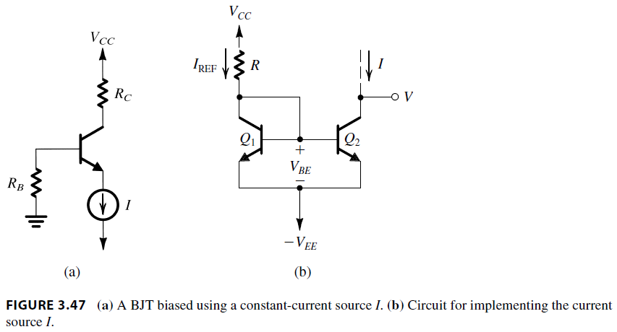

Biasing using constant current source
IE is independent of beta and VBE.
RB can be made very large to achieve high input resistance.
Gives plenty of freedom for different loads.
© Oxford University Press 2013. All rights reserved.

Slide 19


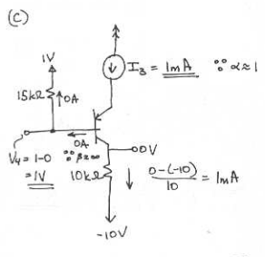
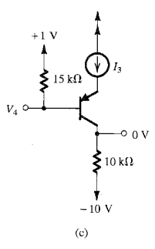

Slide 20
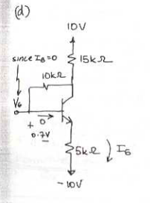
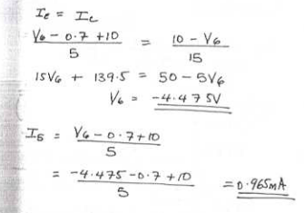
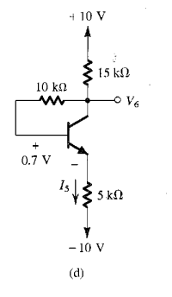
5.20 (d)

Slide 21

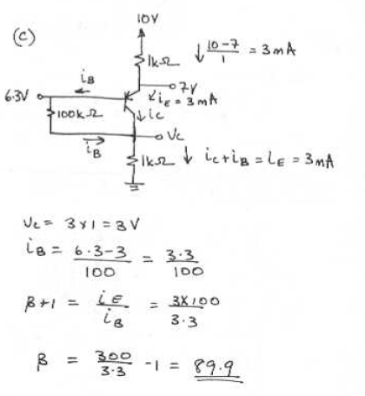
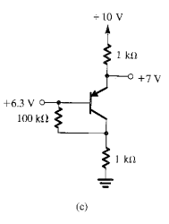

Slide 22

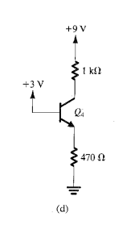
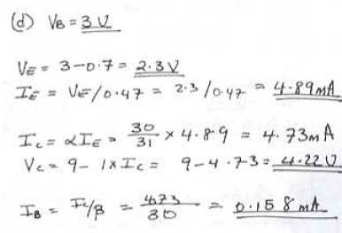

Slide 23

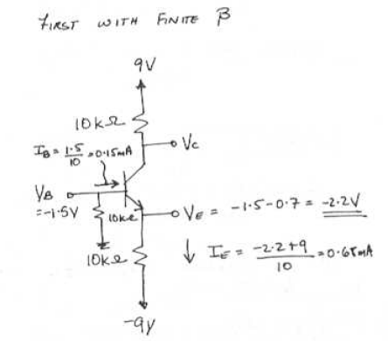
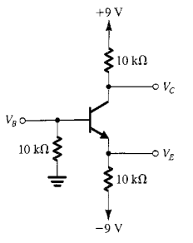
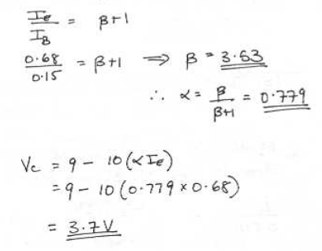

Slide 24
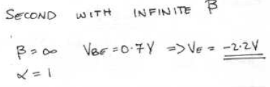
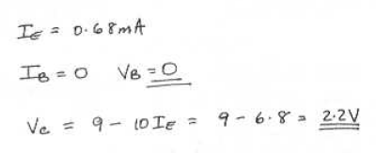

Slide 25

